Slide 1
Bayesian Spiking Networks
expectation maximization & Homeostatic plasticity
Based on Habenschuss et aL.

Slide 2
Content
Quick Reminder
Generative Model
Learning Rules
Reproducing Results
Timescale Dependence of Performance
Reconstruction Capacity of the Network
Open Questions & Conclusion

Slide 3

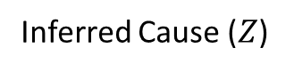
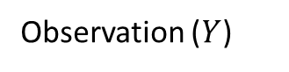
Assumption: Brain has Cause-based Model of the World
"Tiger"
Real Cause
Observation ($Y$)
Inferred Cause ($Z$)
Goal: Infer P(Z|Y)
Images taken from [7, 8]

Slide 4
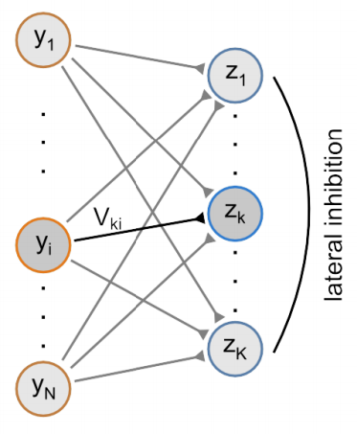
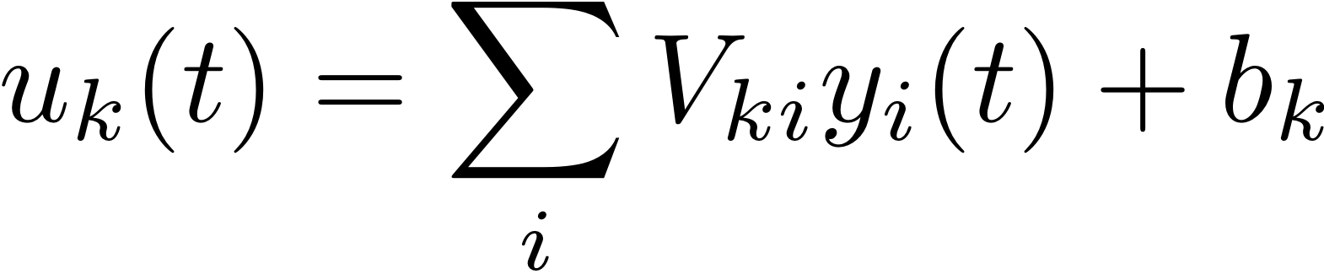
Generative Model and Corresponding Network
Inputs are caused by different causes, represented by different neurons
Causes are exclusive – Only one neuron is active at a time
Expectation Maximization can be used to derive learning rule
Weights
Input
Intrinsic Excitability

Slide 5
Learning Rules: Weight Update
Weights
Input
Intrinsic Excitability
Update only weights to neuron that fires now
Match weight to input frequency

Slide 6
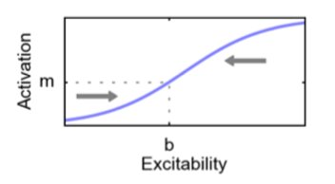
Learning Rules: Homeostatic plasticity
Weights
Input
Intrinsic Excitability
Target firing rate
Does neuron fire now?

Slide 7
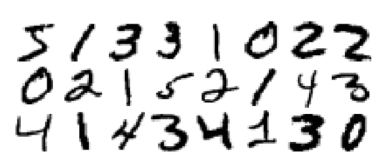
Data Preparation
Work on binarized MNIST images (digits)
One input neuron per pixel → 784 inputs
Present every image for 0.250s
Habenschuss et al.
Model input as Poisson spike trains
Ours
Model input as constant values
Images taken from [3]

Slide 8
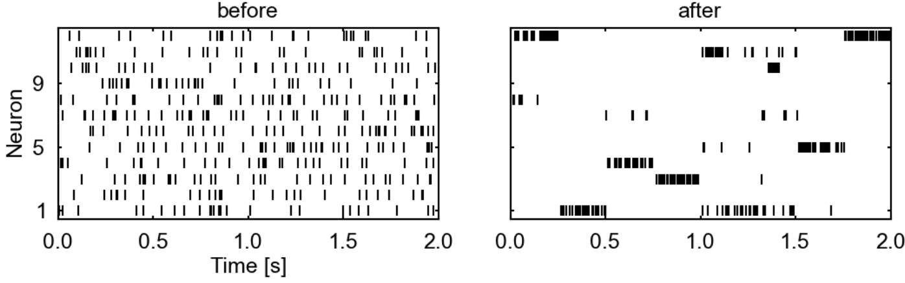
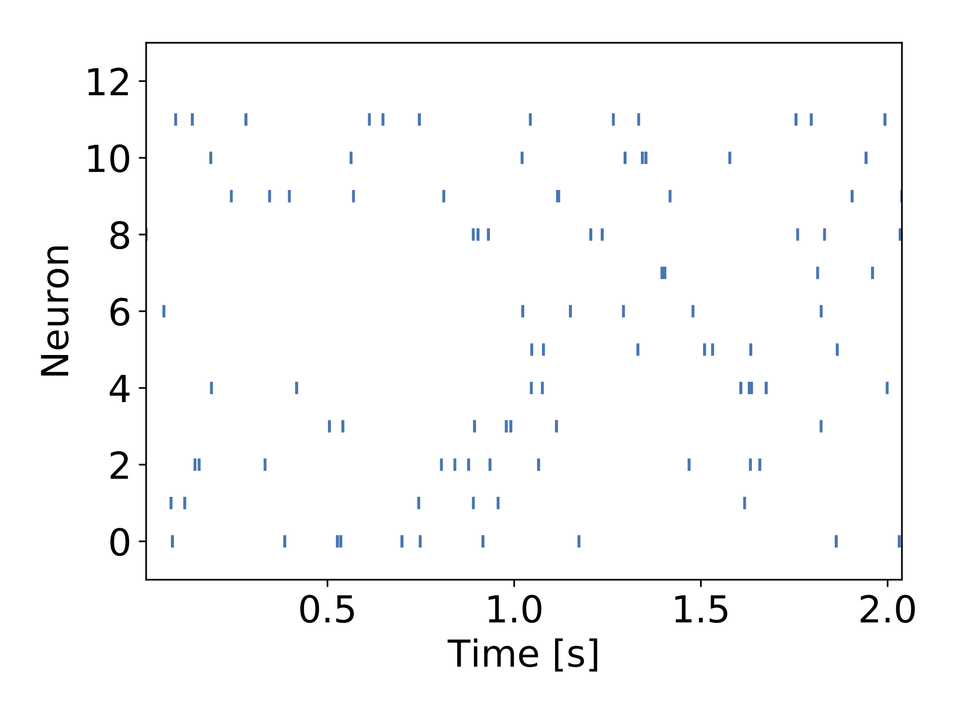
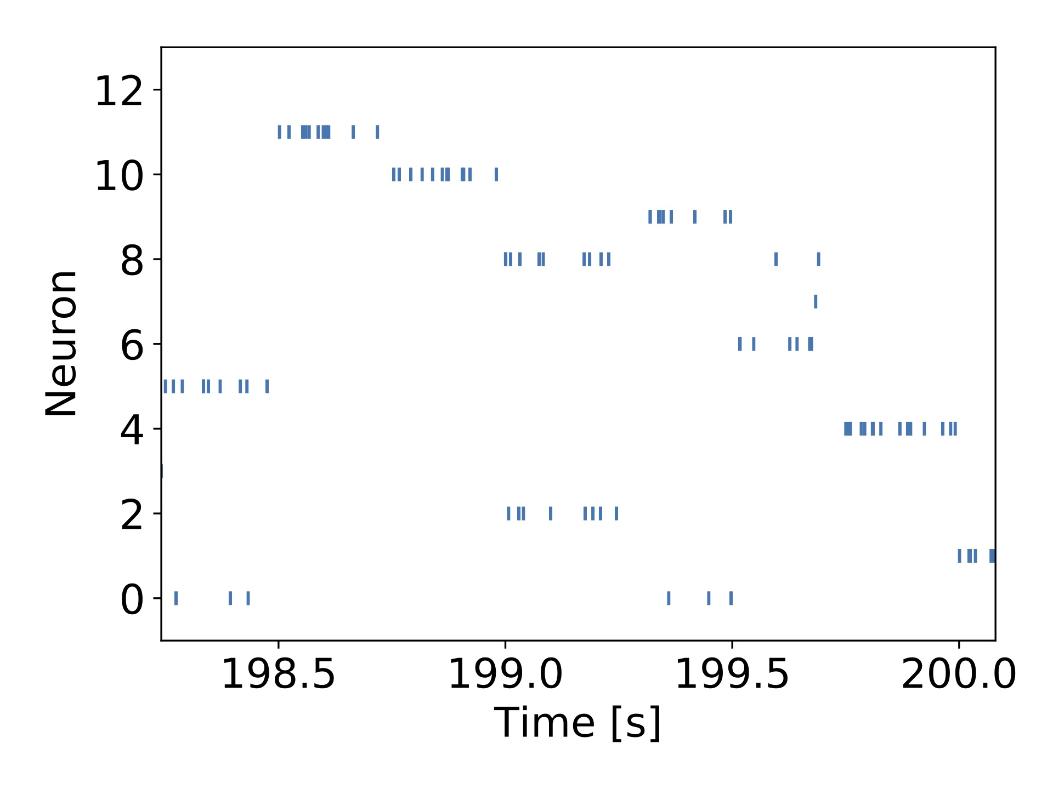
Network Learns Sparse Coding
Habenschuss et al.
Ours

Slide 9
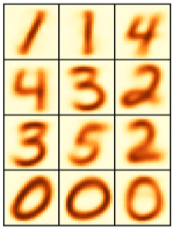
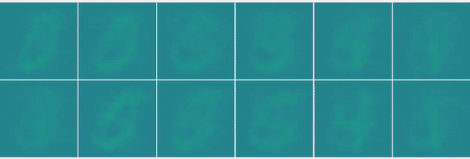
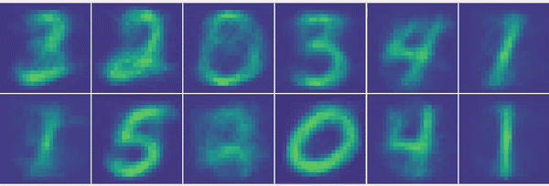
Temporal Evolution of Weights
Habenschuss et al.
Ours

Slide 10
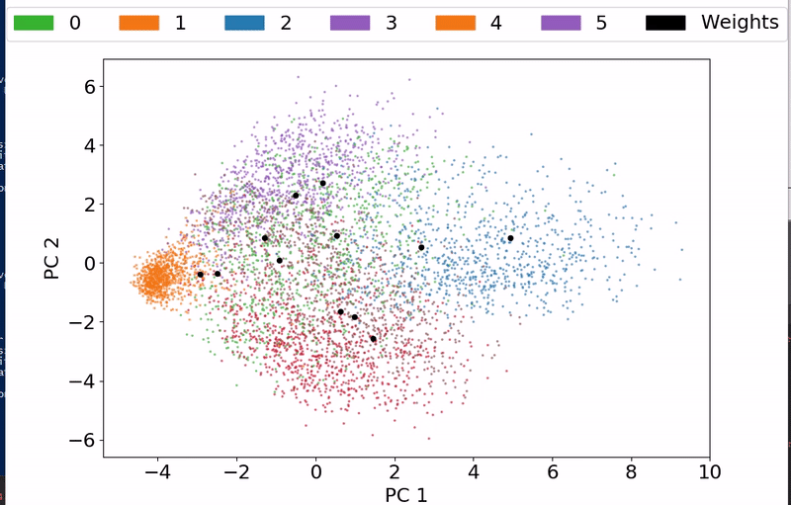
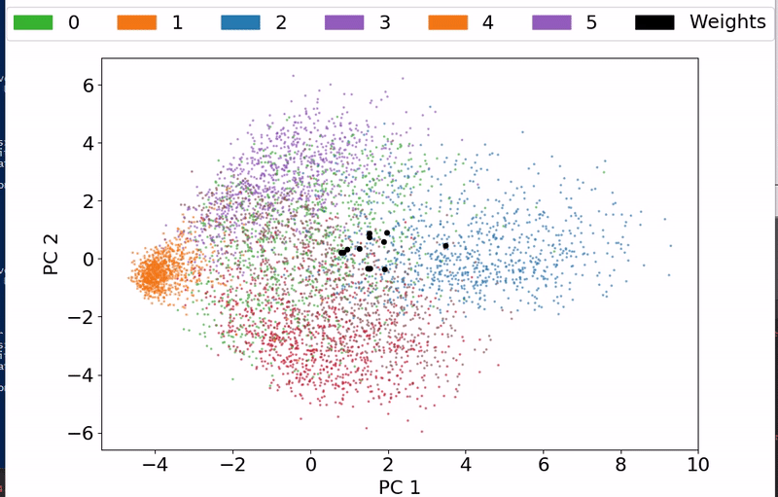
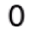
Weights Distribute over the Input Space

Slide 11
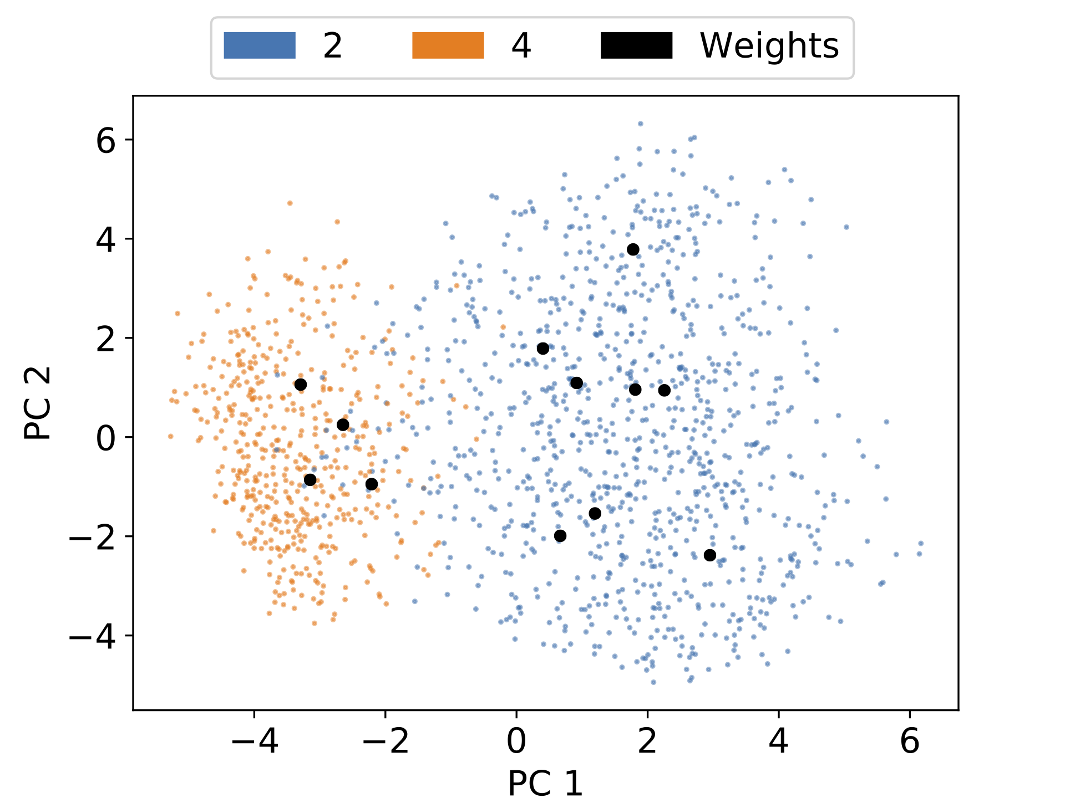
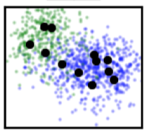
Ratio of Input Classes Reflected in Weights
Input Ratio: 2:1
→ Neuron Ratio: 8:4
8
4

Slide 12
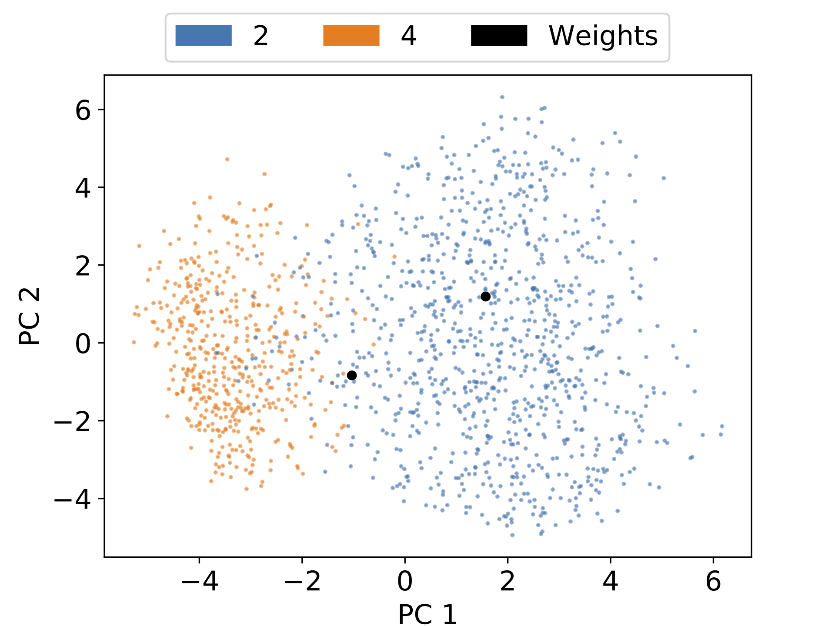
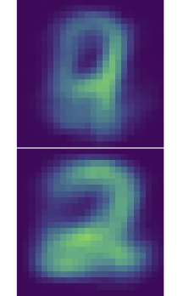
Superposition of Causes if too Few Neurons
Input Ratio 2:1
Two output neurons cannot capture that
One neuron stays between both numbers

Slide 13
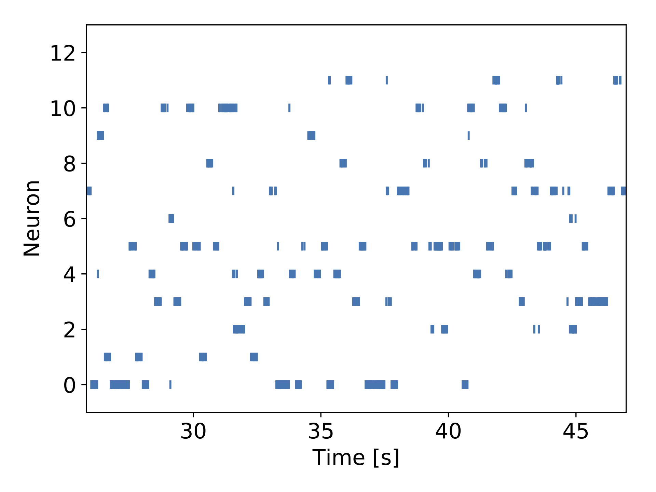
Training Highly Sensitive to Learning Rates
Homeostasis has to be much faster to ensure constant average firing rates
Learning rates scale differently
If bad values are chosen:
Homeostasis breaks
Ratio of neurons no
longer represents input ratio
Low firing frequency
High firing frequency

Slide 14
Network is Able to Reconstruct Inputs
Present image for $∆t$
Present image for ∆𝑡
Count output spikes
Weighted sum of neuron weights
Input
Reconstruction

Slide 15
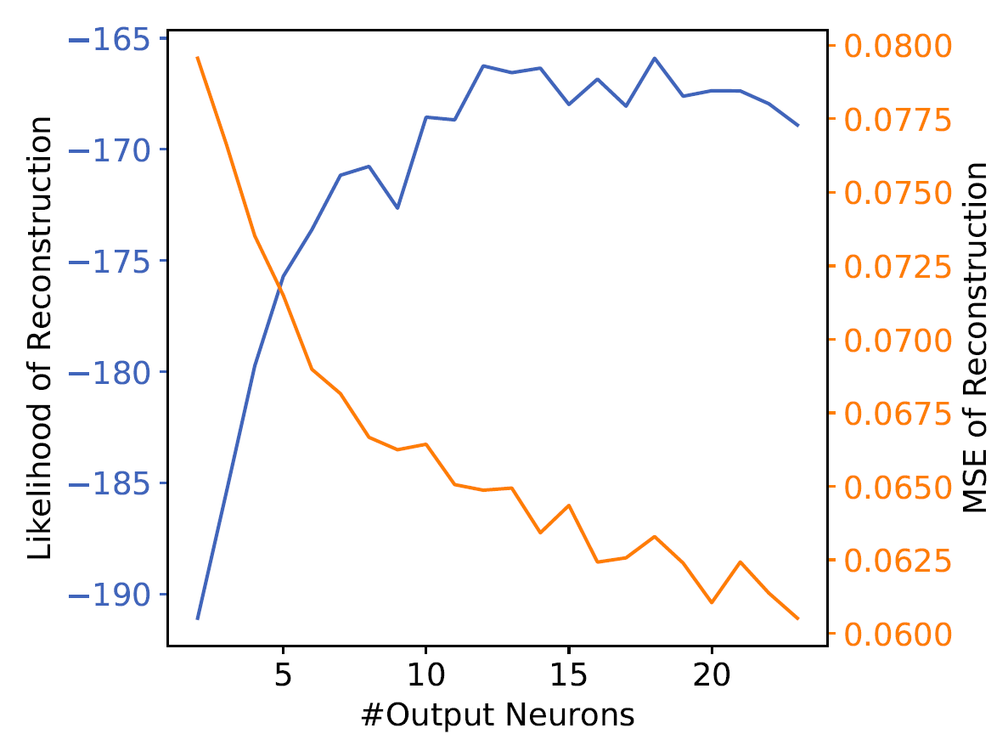
Performance Increases with Network Size
Network can reconstruct unseen data → Generative model captures input space well
Increasing network size improves reconstruction
log-

Slide 16
Conclusion
Dynamics have two timescales
Homeostasis has to be much faster
Too few neurons for causes lead to Learning of superposition states
Network can reconstruct images is was not trained on

Slide 17
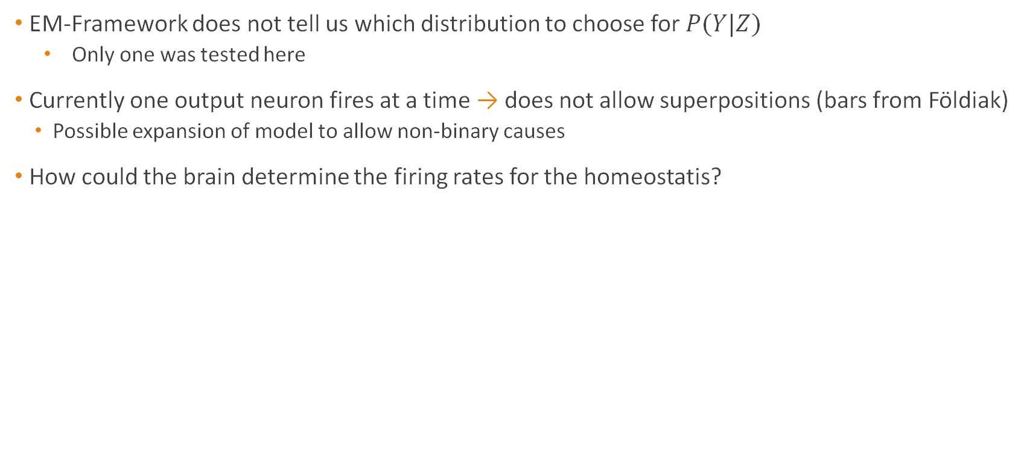
Open Questions
EM-Framework does not tell us which distribution to choose for $P(Y|Z)$
Only one was tested here
Currently one output neuron fires at a time → does not allow superpositions (bars from Földiak)
Possible expansion of model to allow non-binary causes
How could the brain determine the firing rates for the homeostatis?

Slide 18
References
[1] Habenschuss, Stefan, Johannes Bill, and Bernhard Nessler. "Homeostatic plasticity in Bayesian spiking networks as Expectation Maximization with posterior constraints." Advances in Neural Information Processing Systems. 2012.
[2] Földiak, Peter. "Forming sparse representations by local anti-Hebbian learning." Biological cybernetics 64.2 (1990): 165-170.
[3] Nessler, Bernhard, Michael Pfeiffer, and Wolfgang Maass. "STDP enables spiking neurons to detect hidden causes of their inputs." Advances in neural information processing systems. 2009.
[4] Keck, Christian, Cristina Savin, and Jörg Lücke. "Feedforward inhibition and synaptic scaling–two sides of the same coin?." PLoS computational biology 8.3 (2012): e1002432.
[6] Bishop, Christopher M. Pattern recognition and machine learning. springer, 2006.
[7] Vectorstock. vectorstock.com/royalty-free-vector/colorful-sound-waves-vector-11771199
[8] Indiatoday. indiatoday.in/india/story/west-bengal-injured-man-in-hospital-claims-tiger-attacked-him-1188042-2018-03-13

